Slide 1
The Progression to Sonship Via Coaching
From Conversations in the Council to Co-Laboring on Earth
John’s Book – Sonship, Ascension, and Reformation
1) Starting place – Hearing God’s Purpose for Me… and getting it in writing
Life/Business
Purpose In a
Purpose Profile
“Prophetic Why”
Your Aspirations
Where will I be?
How will it Feel?
What is Father Doing?
What’s my Next Step?
Your Story
“Origins”
Your Offer
“Value”
One Page
Business Plan
Cash Flow
Your Intentional
Kingdom Business
Brochure
John’s Example
Justin’s Example
2) Living Words – Learning to Go to the Courts and Council myself… and impacting my Business culture
Intro Identity
Who you are
Why You’re Here
Where you’re Going
Demolishing Strongholds
Courts of Heaven
7-Spirit Profile
Guidance Doc
One Page
Culture Plan
Your Intentional
Kingdom Culture
Brochure
John’s Example

Slide 2
What Sons Bring Back to Business
From 9 Conversations in the Council
Our Hunger
God’s Council
Father
(I AM Yahweh)
Jesus
(I AM Your Redeemer)
Holy Spirit
(I AM Bread, Spirit of Truth)
Wisdom
(I AM the Light)
Understanding
(I AM the Door)
Counsel
(I AM Good Shepherd)
Might
(I AM Resurrection Life)
Knowledge
(I AM the Way)
Fear of the Lord
(I AM I the Vine)
God’s Council Transformations from Conversations
Father → Identity – I’m a Chosen son, a Solutionary; overcomer
(I Am Yahweh)
Jesus → Story – My past, present, and future are redeemed for destiny
(I Am Your Redeemer)
Holy Spirit → Purpose – I’m in step, in sync with Father’s purpose
(I AM Bread, Truth)
Wisdom → Strategy – Living Words release Father to add all these things
(I Am the Light)
Understanding → Tactics – Living Words release my creativity, initiative, open doors
(I am the Door)
Counsel → Heritage – Ask and I will give you the Nations, Ps 2:8
(I Am Good Shepherd)
Might → Courage – you can resurrect from loss, multiply from Victory
(I Am Resurrection Life)
Knowledge → Clarity – Sons convert Living Words to Greater Works on Earth
(I Am the Way)
Fear of the Lord → Culture – I see what people carry, Ecclesia@Work = shared purpose
Who Am I?
Why Am I Here?
Sons With Purpose
How Lord?
Ascend and Align
Where Am I Going?
Passion for Reformation

Slide 3
Purpose Profile
(Name)
13.
1.
14.
2.
15.
3.
16.
4.
Connection to Reformation
Create Value
Purpose Statement –
To: Mission – what we do
So that: Purpose – why we do it
God and Family
Minister to people
9.
5.
10.
6.
11.
7.
12.
8.

Slide 4
7 Spirit Profile - From Strongholds to Sonship From Demolishing Strongholds
9 Conversations Via God’s Council of Sons (Faith from Hearing in the Council Rom 10:17) | Nine Topics | Old Pretensions “Accusations” Perceived Lack (Fortress/Stronghold of 2Cor 10:4-5) | 9 New Truths Decrees From Courts of Heaven (Chosen, Placed Sons Jn 15:16) | Seven Compelling Reasons
Yahweh continually guides and provides Mercies & Manna new every morning | Identity |  |  | Fun (Chosen)
Jesus keeps revealing, redeeming divine preparation in my history | Story |  |  | Fun (My Story)
Holy Spirit is speaking living words Prophetic decrees with power | Purpose |  |  | Fun (Purpose)
Wisdom shines a light a new ways A pattern of creative ideas | Strategy |  |  | FLOW (Creativity)
Understanding Opens doors Father has gone before me | Tactics |  |  | FAT - Father Adds Things
Counsel is shepherding me a much larger context; bigger than me (Kingdom) | Heritage |  |  | Following (the Lamb)
Might is giving hope for resurrection I am a son, destined to be an overcomer | Courage |  |  | Greater Works
Knowledge puts the path in a story I can explain; it makes sense | Clarity |  |  | Reformation of Nations
Fear of the Lord is showing what people carry, how to honor them, Ecclesia | Culture |  |  | Love (Fathering)

Slide 5
7 Spirit Profile - From Strongholds to Sonship From Demolishing Strongholds
9 Conversations Via God’s Council of Sons (Faith from Hearing in the Council Rom 10:17) | Nine Topics | Old Pretensions “Accusations” Perceived Lack (Fortress/Stronghold of 2Cor 10:4-5) | 9 New Truths Decrees From Courts of Heaven (Chosen, Placed Sons Jn 15:16) | Seven Compelling Reasons
Yahweh continually guides and provides Mercies & Manna new every morning | Identity | I’m an orphan, fending for myself | I’m a son, whose Father provides and guides | Fun (Chosen)
Jesus keeps revealing, redeeming divine preparation in my history | Story | My life makes no sense Has no purpose, theme | Jesus redeemed my Story It is a hero’s Journey | Fun (My Story)
Holy Spirit is speaking living words Prophetic decrees with power | Purpose | I did my own thing, whatever (felt right, seemed good, made money) | I’m doing what Father is doing Saying what He is saying | Fun (Purpose)
Wisdom shines a light a new ways A pattern of creative ideas | Strategy | I didn’t have a strategy I copied from others | I’m on my unique course that Father is confirming | FLOW (Creativity)
Understanding Opens doors Father has gone before me | Tactics | I’m following, copying someone else’s recipe | I’m co-laboring with Father Releasing His power & Wisdom | FAT - Father Adds Things
Counsel is shepherding me a much larger context; bigger than me (Kingdom) | Heritage | I don’t have one Trying to create one | Father is going beyond all I can ask or imagine | Following (the Lamb)
Might is giving hope for resurrection I am a son, destined to be an overcomer | Courage | I am brash, until I’m not | I’m heroic; there is a larger cause I don’t have to survive; no fear | Greater Works
Knowledge puts the path in a story I can explain; it makes sense | Clarity | My life and business Feel like the fog of war | Father is showing where this leads Can articulate where I’m going, Why | Reformation of Nations
Fear of the Lord is showing what people carry, how to honor them, Ecclesia | Culture | It’s a culture of accountability “following the recipe” | Others are gathering, volunteering Around Father’s shared purpose | Love (Fathering)

Slide 6
The Denver Meet→”UP” (2 Things we all Face)
1) Accusations (Courts of Heaven)
Discern Enemy Accusations
Rev 12:10
Agree with our adversary quickly
Mt 5:25
Identity Spiritual
Roots → Cross
Bring Back Father’s Decrees
2) Trials, Setbacks, Impatience (Council Conversations)
Seated in Heaven
Father’s Council
Jn 1:1, 14:2-3, Eph 2:6
Conversations
7 Spirits
(Isa 11:2, Rev 1:4, 4:5, 5:6)
Bring Back Father’s Decrees
(From 9 Conversations)
Release the Lion
Spirit of Truth
Ascending to the Council Made Simple
Sonship & the Divine Council
Court & Council Tool Kit
The Roadmap to Sonship
Lead your Tribe Into Sonship
Lead Your Tribe Playbook
7 Spirit Assessment
Helpful Links

Slide 7
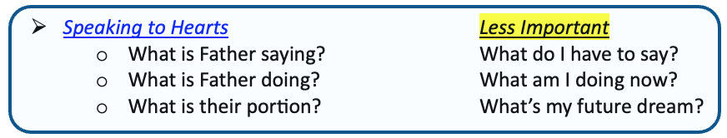
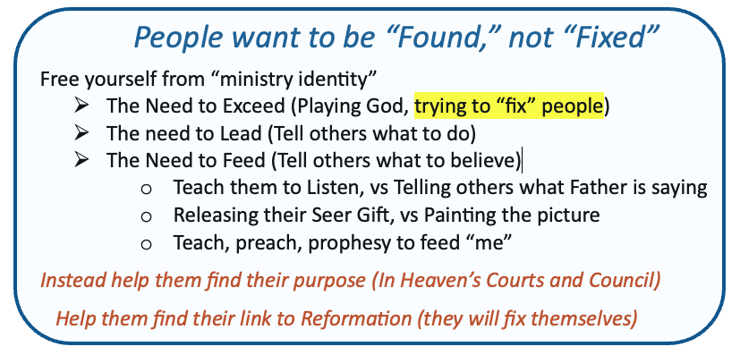
The first Court Session?
Stories
Rick
The Council Guide
Breadcrumbs
https://releasingkings.com/wp-content/uploads/2026/04/2026-04-06-Council-Meetup.pdf
https://releasingkings.com/wp-content/uploads/2026/04/2026-04-13-Council-After-the-Meet-UP-003-jc.pdf

